Slide 1
Welcome to Grade 8!

Slide 2
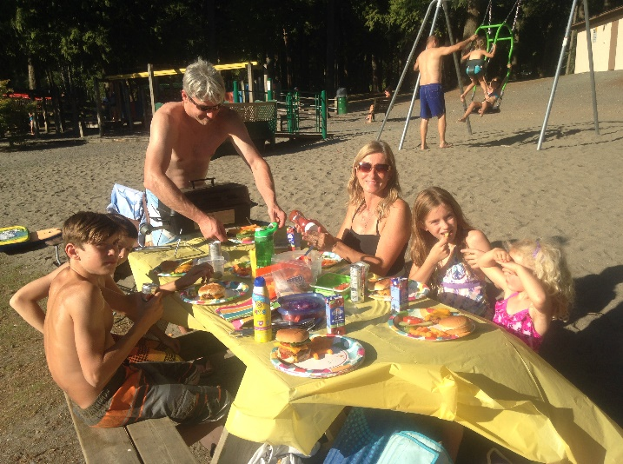
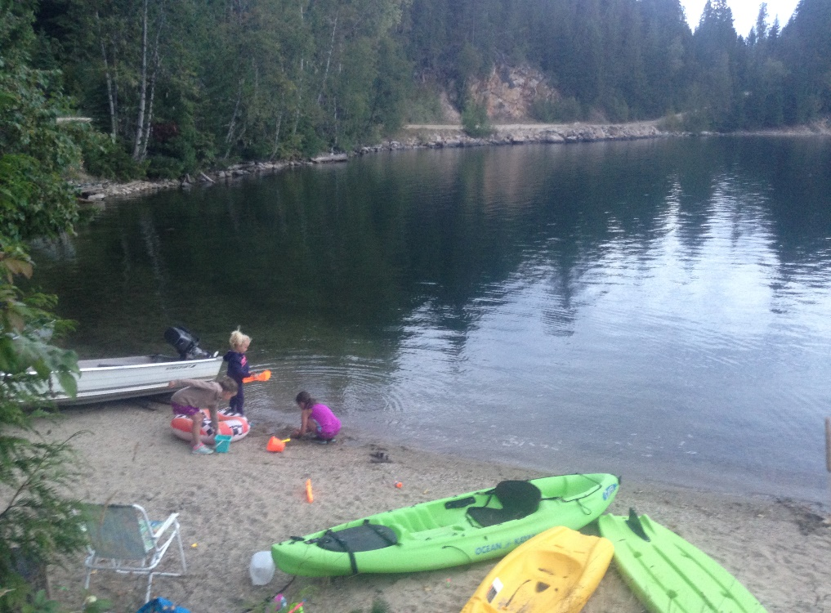
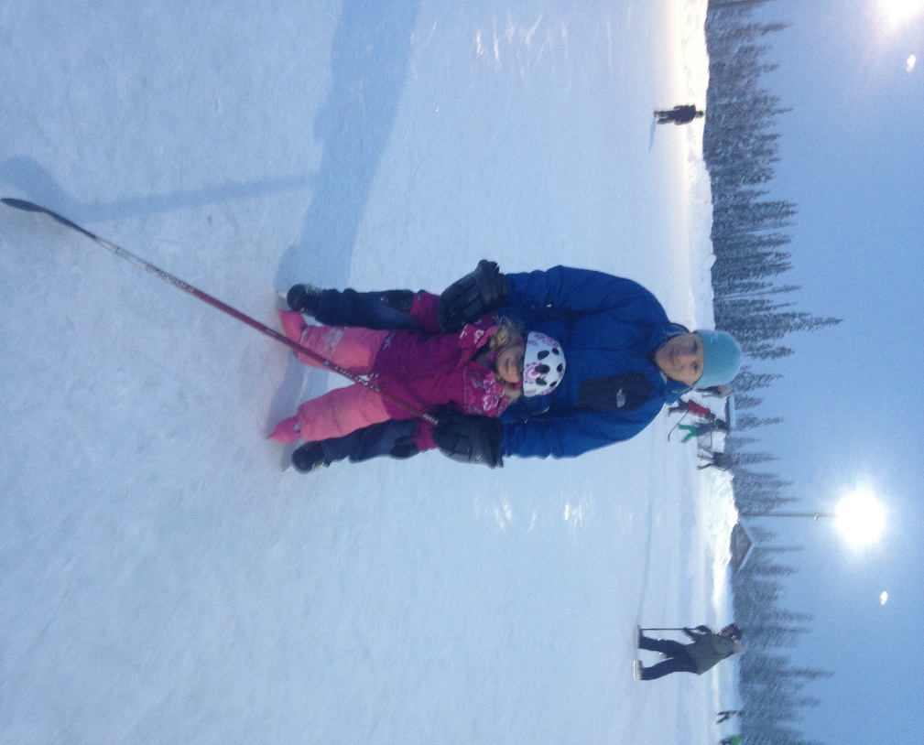
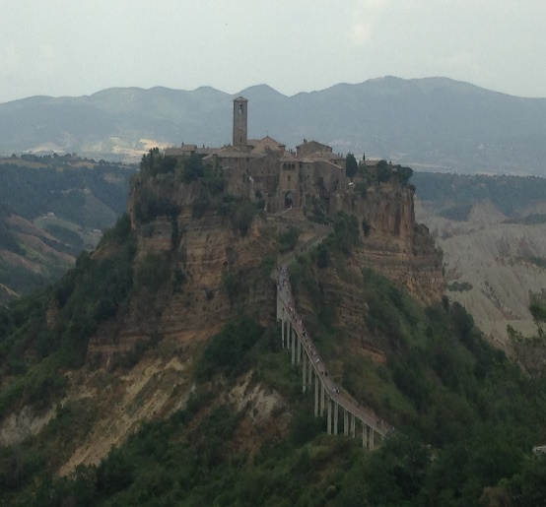
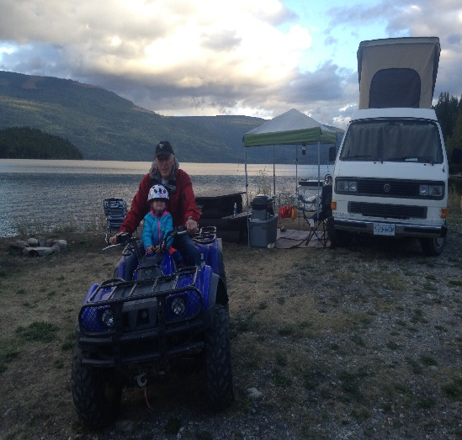
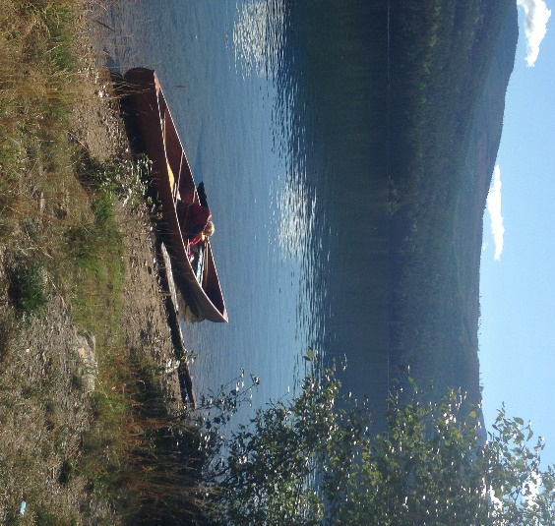
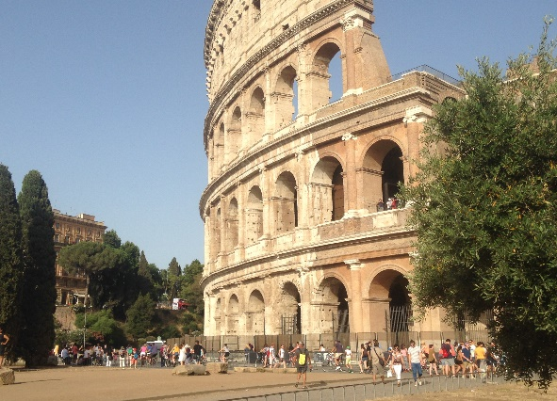
Mrs. H-G

Slide 3
About me!
My favorite activity is to travel, and my goal is to have touched on every continent by the time I am 55.
I lived in China and learned what it was like to look completely different, be completely illiterate, not know the language, and still learning to function in society.
I love adventure… I salmon fish, camp, climb, ski, canoe, kayak, bike, hike, skate, blade, ice wall climb, paraglide, and will do pretty much anything!
Biggest success – I am standing here. I could not read until fourth grade. I am dyslexic and I still struggle if I am tired. I thought I was stupid because I could not do what my peers could do, BUT once I LEARNED HOW TO DEAL WITH IT… SUCCESS!!!! By high school I was on the honor roll and then had a high enough GPA to get into university.
FACING FEAR… FEAR of being different. FEAR of the unknown. FEAR of Failure… FEAR is our biggest obstacle. ONLY YOU ARE STANDING IN YOUR OWN WAY!

Slide 4
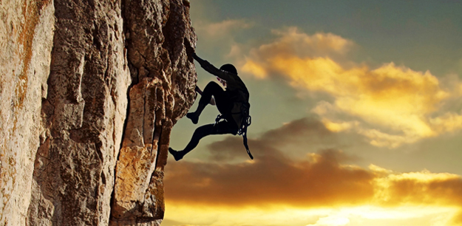

Slide 5
Challenge yourself!
Failure is part of learning.
(Period!)
Reach the next level & keep going!

Slide 6
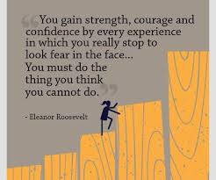

Slide 7
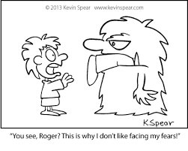
What you can expect from me…
I will do EVERYTHING I can to help you reach your goals this year.
I encourage and expect that we all experience failure on the road to success. We will keep our first drafts, second, third… however many times it takes until we are happy with our progress and have met the goal we set. If you are not struggling and it is coming easy to you… YOU did not challenge yourself!
Everyone is at a different place. Everyone has strengths and weaknesses. Help-out if you are strong, accept help if you can use it, use the expertise in the classroom to help you achieve to the best of your ability.

Slide 8
Be responsible for your success!
Have a few people you can call to get help. Get numbers NOW!
Use the website: khardy-guarducci.weebly.com
Email Mrs. Hardy-Guarducci – karry.guarducci@sd23.bc.ca
Keep your notes in order and assignment sheets and rubrics so you know what you are doing.
Use a calendar for all major assignments and events.
Don’t be afraid to ask… I only bite once in a while! It is my JOB to help you… so let me! Use the website/Google Classroom to stay on top of work.
If you are an A+++++ student… get creative! How can you add something of interest, go above and beyond, … let’s talk about what would be super cool and related!

